Slide 1
Commercial Property
State of the Market/Strategies
Presentation to CAA
May 8th, 2025

Slide 2
Today’s Agenda
Introduction
State of the Domestic Property Marketplace
  Understanding the Wholesale Arena
Challenging Industry Classes
  CAT Perils, i.e., Wind, Earthquake (EQ), Wildfire
  Modeling Capabilities for CAA
Conclusion & Questions

Slide 3
RT Property
RT Specialty Team
Drew Zadow
SVP – Real Estate - Construction - Industrial
Drew.Zadow@rtspecialty.com
C: 214-728-3203

Slide 4
State of the Domestic Property Marketplace: Current & Future
What we are seeing:
In the marketplace:
  Continued admitted carrier pull back, flowing more business into the surplus lines market although that flow has become more pocket oriented and slowing in many classes/geography
  Hard market conditions 21-23 due to increased severity and frequency of weather-related losses have peaked for the time being
    CAT losses still driving pockets of hardening market
    Secondary perils (wildfire, convective windstorm, water damage, freeze losses) are becoming primary perils
  Focus on valuation slowing as of 2024-25 but still a topic of conversation
  Risks are generally down 10-15% YOY unless coming out of admitted market into E&S. Some 25-35% particularly in areas like coastal wind where rates ran so hot for 4-5 years.
Looking ahead to mid year reinsurance renewals:
  6/1 renewals ? as we digest Palisades and Eaton fires. ~ $40b event will have small impact but likely slows/stalls soft market conditions and doesn’t throw us back into a hard market
    Another busy year for severe convective storms was the driving force behind last year’s $182.7B+ of catastrophic losses. Beryl, Milton and Helene NWS had impact. Helene flooding in NC.
  The new RMS 2023 version has been very favorable to coastal property risks as rates peaked in 2024

Slide 5
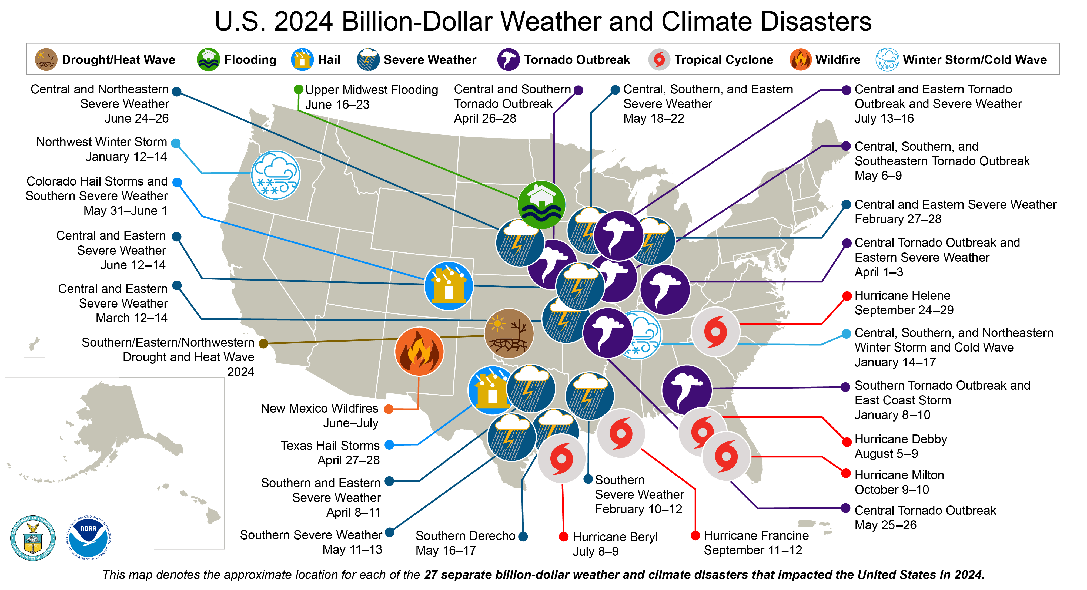
U.S. 2023 Billion-Dollar Weather and Climate Disasters
Source: National Centers for Environmental Information / National Oceanic and Atmospheric Administration, Nov. 2023

Slide 6

Challenging Industry Classes
Frame Habitational – From our perspective:
  Capacity is back with new programs coming online quarterly
  Decreases across most properties in the E&S market particularly on multi location portfolios
  Affordable housing, aluminum wiring, older frame or JM construction, poor loss history, low valuation and lack of sprinkler protection are still the toughest business to place in the class but still driving YOY decreases for many
High Hazard Manufacturing – From our perspective:
  Include woodworking, recycling and chemical type risks. Submission quality is critical. Engineering is necessary and we encourage procuring that on the front end if you do not currently have inspections to share.
  Important to understand the nuances of the manufacturing processes to gain market comfort, i.e., dust collection procedures, mixing and blending operations - Is there a manufacturing component or truly a blending operation?
  Stock throughput policies can help broaden terms and typically are more cost effective than throwing into the property policy

Slide 7

Challenging Industry Classes, continued
Agriculture / Food Processing – From our perspective:
  Still a challenged class of business due to overall market performance. Inventory losses are costly and typically the Business Interruption (BI) becomes exorbitant in cases of loss.
  Standard markets still right sizing their book and pulling out of the space moving from a ground up placement to shared and layered.
  It is important to understand the BI portion of your risk. Is the stock valued at selling price or replacement cost? What makes most sense for your risk and is the BI being accounted for accordingly.
Builder Risk – From our perspective:
  New frame markets with increased capacity even for podium/single building. Some rate softening.
  Previous bridge/road, superior construction real estate, sports stadiums, etc projects on master programs are needing capacity build out as master carriers no longer comfortable with large limits particularly in CAT zones
  Monitored cameras continue to be needed on larger projects in lieu of traditional overnight security

Slide 8
CAT Perils
Convective wind losses are at a record level and representation of losses to the market have increased over 90% in the past 5 years.
Markets used to feel confident in where they could write business to avoid convective losses, but as history has proven, tornadoes and straight-line winds can pop up just about anywhere.
It is a nearly impossible peril to model
Texas continues to be very tough for older, lighter construction with aggregation of values, 100% TX schedules marketed will experience more punitive results than a schedule with a spread of risk.
Wildfire has limited market participation due to the possibility of total losses, as well as few markets being able to consider excluding the peril on the risk due to fire following laws.
Expect small lines with limited participation. Markets are pulling wildfire scores on every single risk. If you have a risk with a score over 50, market availability will start to shrink, anything that is 75 or over the participation will shrink even further. Rural areas in TX and all over the country experiencing market scrutiny.
Expect hefty rates with massive retentions. The more information the better regarding brush clearance and any kind of risk mitigation to share in marketing.

Slide 9

RT Specialty CAT Modeling Capabilities
Soon after our inception, Ryan Specialty licensed RMS catastrophe models. In 2019 the Ryan Specialty CAT Modeling Team was formed, staffed by professionals in the modeling field, and led by Javier Perez, Ph.D. Structural Engineer, who has worked with CAT models since the mid 1990’s.Today, the team runs RMS models for all of Ryan Specialty, including Programs and MGUs, and runs AIR by exception, and has further offerings in development.
RMS Models licensed by Ryan Specialty:
  North Atlantic Hurricane, Texas to Maine, also Hawaii
  Earthquake, all 50 states
  Severe Convective Storm, 48 contiguous States
What is needed to ask your RT Specialty Broker to seek a model report:
  Clean Excel SOV, with the usual elements of an SOV you would go to market with
  Deductibles for each model peril
  Limits if inclined to run Layers, or model can run without limits
  Typical turnaround 2 to 3 workdays
  Report Output is an RT Specialty branded report in PDF, with key model results, geographic results, and data summaries

Slide 10
RT Property: Overview of our Practice
OUT THINK. OUT WORK. OUT EXECUTE. REPEAT.
RT Property has been a fast-growing team since its founding in 2010. The RT Property team takes pride in their commitment to service, striving to always be an advocate for our retail partners and their clients.
CLASSES OF BUSINESS:
KEY AREAS OF EXPERTISE:
Energy, Marine, Oil & Gas, Renewables
Healthcare Risks
Manufacturing
Technology & Communications
And More!
Catastrophic Exposures:
Coastal Wind
Earthquake
Flood
Pandemic
Severe Convective Storm
Real Estate:
Condos / HOAs
Commercial
Mixed Use
Multi-Family Housing
Vacant Property
Specialized Coverage:
Builder’s Risk
Deductible Buy-Backs
DIC Placements
Large Deductible Placements
Stock Throughput

Slide 11
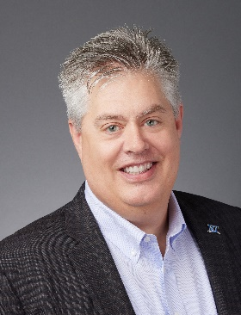
RT Specialty Claims
Todd Mannschreck
President - Chief Claims Officer
RT Specialty
todd.mannschreck@rtspecialty.com
816.714.7431
RT Specialty employs a team of talented and motivated claims professionals to assist our clients on all claim issues, which has proven to be an asset to our retail brokers and their clients. Some key benefits include:
Assistance with claims disputes
Special claims handling procedures
Claims reporting and follow-up
Executive leadership involvement

Slide 12
Thank You!
Drew Zadow
SVP – RT Specialty - Property
214-728-3203 Drew.Zadow@rtspecialty.com
RT Specialty is a division of RSG Specialty, LLC, a Delaware limited liability company based in Illinois. RSG Specialty, LLC, is a subsidiary of Ryan Specialty, LLC. RT Specialty provides wholesale insurance brokerage and other services to agents and brokers. As a wholesale broker, RT Specialty does not solicit insurance from the public. Some products may only be available in certain states, and some products may only be available from surplus lines insurers. In California: RSG Specialty Insurance Services, LLC (License #0G97516). ©2023 Ryan Specialty, LLC

