Slide 1

BOARD MEETING
Tuesday, November 15, 2023
New Orleans, LA

Slide 2


AGENDA
  CAA 2023 PROGRESSION
  2023 YTD RESULTS
  STAFF & COMMUNICATIONS UPDATE
  CAAIS UPDATE
  INDUSTRY/CARRIER UPDATES
  NEW/EXISTING MEMBER UPDATE
  KPI UPDATE
  PREMIUM FINANCE UPDATE
  FUTURE MEETING INFORMATION

Slide 3
CAA 2023 PROGRESSION

Slide 4








CAA2023
“if we were sitting here 3 years from today, we would be happy…”
Member commitment to being a good partner
Member commitment to profitable agency growth
100% Member participation in CAA Strategic Plan & Initiatives
ACCOUNTABILTY
CULTURE
$1.5 BILLION Premium Volume=$180M Revenue
$1.5B
Break-even budget
1% COST
Documented strategy working for carrier partners.
An accountability model working regarding commitments for member agencies
80% AGGREGATED
Excellent, hired and working professional staff with strong communication model
4.5 EMPLOYEE ENGAGEMENT

Slide 5
2023
Goal | Data/ Technology | Carrier Relationships | New Members | Current Member Growth | Deepen Agency Engagement | Continuous Improvement
BoM | AgencyKPI Accountability: Monthly Scorecard Upload Goal: 100% Quarterly Clarity upload Goal: 100% Ongoing verification of codes for carriers – prevents errors in production $$ | Focus on Core Carrier Alignment Update Carrier Liaisons (Q1) Achieve New Business Goals with core carriers Promote CAA, the network, to your carrier relationships | Cultivate a pipeline with prospects Goal: $35 Million in premium (EOY) | 5% Organic Growth Goal Move 5% of non-core to core – use Clarity | Share 2023 agency business plan/goals with CAA 80% aggregation 100% agency representation at meetings Member Engagement Review Goal: 100% Q2 Deepening relationships with CAA staff, benefits | Perpetuation Plans Goal: 100% of agencies have documented plans Continue to champion internal perpetuation among members Define Mission and Vision Statement (Q1)
CAA | Implement a new CRM (Q1) Implement new website (Q2) Clarity: Fully implement Agency KPI (AMS 360/Epic) (Q1) - Use Clarity/Harmony for ’23 planning strategy – use with carrier relationships/ forecast Pilot Wholesale Tuner with 5 members (Q2) – waiting on KPI Implement a system to verify codes by agents at the end of the year (Q4) – use code survey - | Update Carrier Liaisons (Q2) Maximize carrier relationships, contracts & production strategy in all states Distribute profit share in timely-manner Strengthen relationships at the leadership level Attend impactful industry events (need list-Nikki) | Expand in current states (MO, OK, CO, SD, TX) On-board 23 new members prior to July Meeting (Q2) Reconstruct on-boarding process After action review in Q3 (DMAIC) Update new member checklist Develop an on-board evaluation tool for continuous improvement (Q3) Checklist for acquiring new members (expectations) Q2 | Assisting in carrier alignment Help agents move 5% of non-core to core- what could the process be? | 80% aggregation Deepening relationships with member agency/ staff CRM Roll-out (Q1) Assist with “OCT” established from Feb BOM Meeting (Q1)- follow up in Q2 Benefits survey completed (Q1) - done Producer development task force (Q1) – done 3 major meetings – level of engagement/quality – measure agency State Meetings (outside of BoM meetings) (Q2) One per “region/state” Strategic Communication Plan (Q3) | 2024 Strategic Plan (Q4) Quarterly Staff Reviews & Workshops 2/year community service activities (annual) Utilize CRM system to communicate with members(Q2) Evaluate & develop core carrier relationships CAA marketing/branding guidelines (Q1) - done Evaluate vendor relationships (Q3) Aligned benefits with state associations (Q2)
CAAIS | Implement Tarmika in Processes and Procedures (Q2) Utilize Patra to its fullest capacity | Collaborate with CAA on relationship management: Production goals by carrier/by region Track & report progress on goals/production Develop productivity scorecard (strategic) Q2 | Incorporate IS in onboard process Goal: new members using IS New members using new submission checklist MGA analysis – rolling books quicker (Q4) | Strong adoption of IS with a solid % of members Increase volume by agency MGA analysis – rolling books quicker (Q4) Purposeful graduation of members to direct appointments | Member knowledge of IS - who, what, why, how, when? (how to measure?) | Increase Bind Ratio IS Team development Designations: TIIA, ACSR/CISR Continue building new staff structure with regional teams CIS guide- brochure What is CAAIS appetite? Campaign? Announcements? – how to use CRM
Notes:
5

Slide 6
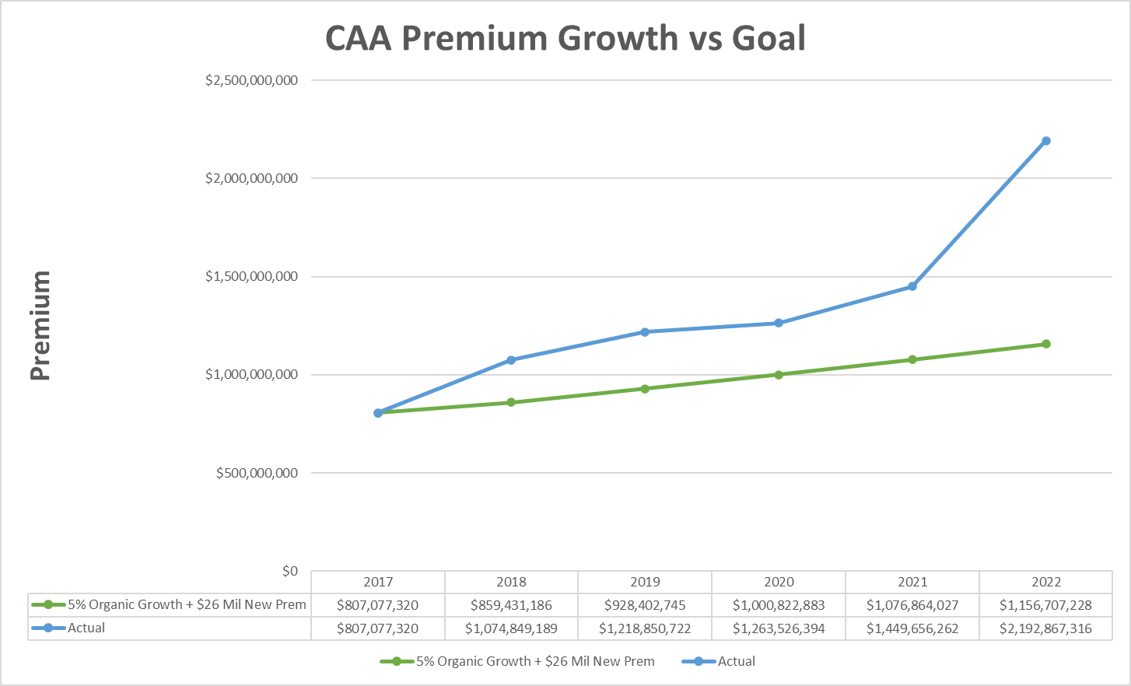
CAA PREMIUM PERFORMANCE

Slide 7
2023 YTD RESULTS

Slide 8
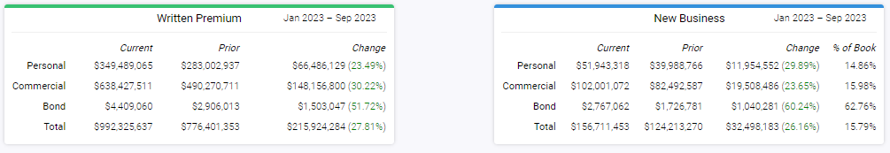
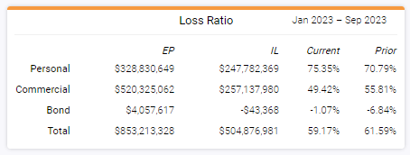
CAA CORE CARRIER PRODUCTION
SEPT YTD

Slide 9
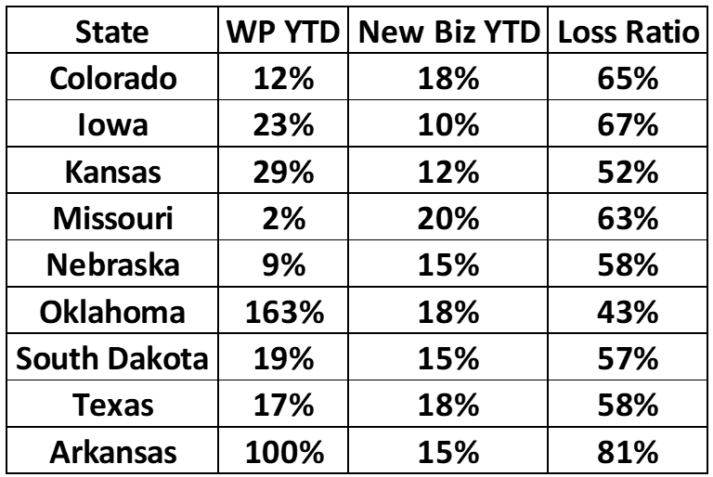
CAA CORE CARRIER PRODUCTION
SEPT YTD BY STATE

Slide 10
STAFF & COMMUNICATIONS UPDATE

Slide 11
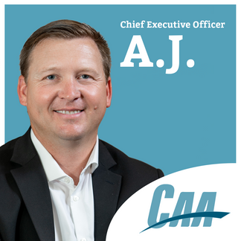
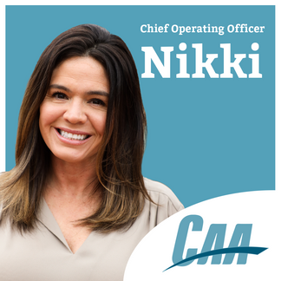
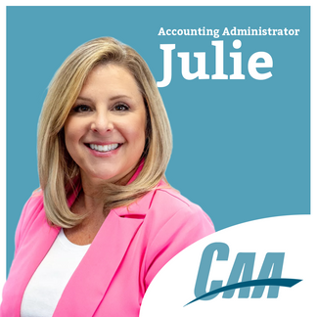
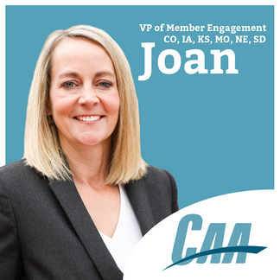
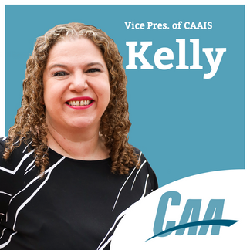
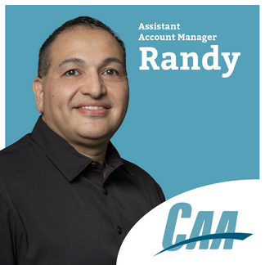
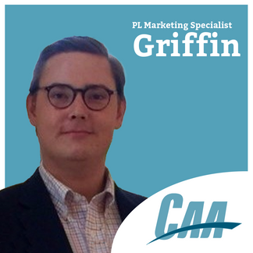
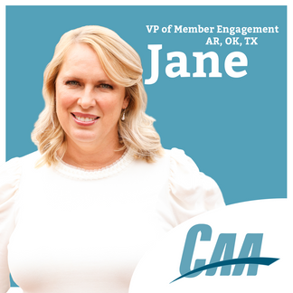

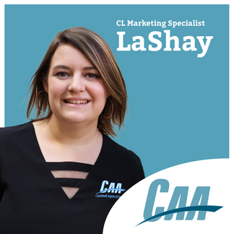

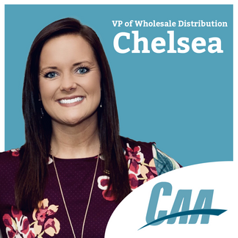
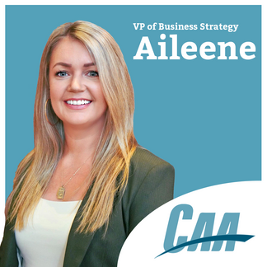
CAA
ORGANIZATIONAL
CHART

Slide 12
CAAIS UPDATE

Slide 13
INDUSTRY/CARRIER UPDATES

Slide 14
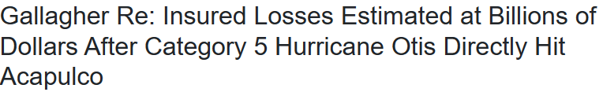

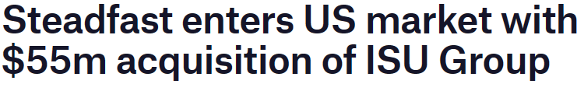


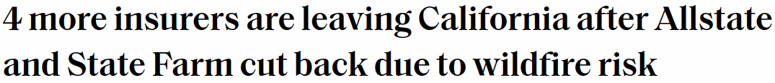

Slide 15
STATE OF THE MARKET
  Hard Market Continues
    Increased Frequency & Severity of Natural Catastrophes
    Economic & Social Inflation
      Nuclear Verdicts
      Prior Year Loss Development
    Deterioration of Personal Home Profitability – Personal Auto Improving
    Reinsurers will miss earnings target for 7th consecutive year
  2023 Mid-Year TCR’s (U.S. Industry 104.5)
    Nationwide – 115.7
    Travelers – 101.4
    Liberty – 109.4
    Auto Owners – 105.7
    Hartford – 94
    Allstate Group – 114.5
    Farmers Group – 117.1

Slide 16
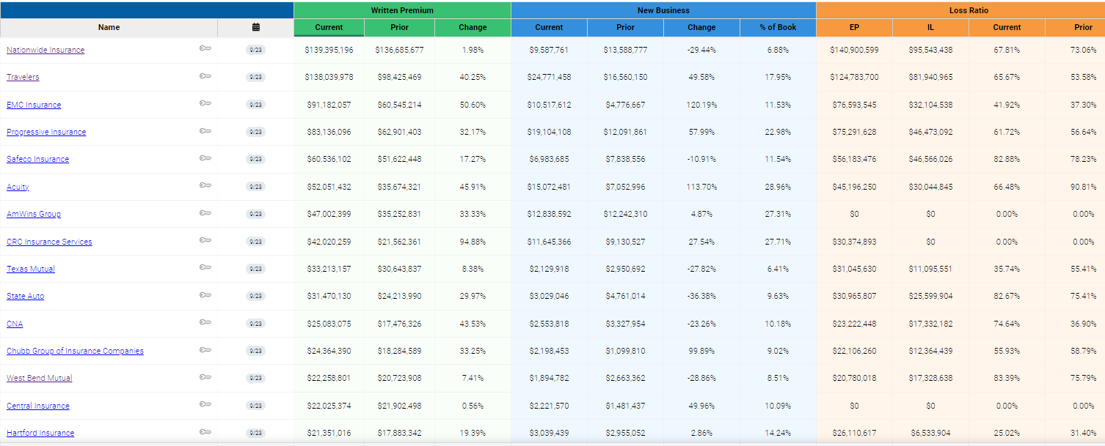

Slide 17

  Locked in PL Profit Share
    1.89% After 10% lock fee
    53.8% Loss Ratio – Over 55% is out of the money
  CL GSC is 3.94%
    Now includes Select Auto
  No planned changes for 2024

Slide 18

  2023 Loss Ratio – 82.9%
    No Profit Share
  2024 Compensation TBD – Expect Standard Profit Share

Slide 19

2023
  Personal Lines Compensation
    1.75% Guaranteed Compensation
    .25% Growth Kicker for 4% Premium Growth
    .25% Loss Ratio Kicker for 62% or less Loss Ratio
  Commercial Compensation
    3% Guaranteed Compensation
    New Business Bonuses TBD
  Farm Compensation
    1.5% Guaranteed Compensation
    2% Growth & Below 60% Loss Ratio 1% Additional Compensation (2% Total)
    2% Growth & Below 50% Loss Ratio 2% Additional Compensation (3% Total)

Slide 20
2024
  Personal Lines Compensation
    1.5% Guaranteed Compensation
    Up to .5% more based on Loss Ratio
  Commercial Compensation
    2.5% Guaranteed Compensation
  Farm Compensation
    1% Guaranteed Compensation
    Up to 1.5 more based on Loss Ratio

Slide 21

2024
  3.5% Guaranteed Compensation
  $2,50,000 New Business Goal – 3% Payout
    Max Payout of $100K
  10% Negative Growth Results in $0 Payment

Slide 22

  Standard Profit Share
  Profit Share – 2.5% as of September
  Exploring 2024 Guarantee

Slide 23

  Central Region 54% Profit Share Eligible Loss Ratio YTD – Locked in $106K
  Texas Region 58% Profit Share Eligible Loss Ratio YTD - $0 Profit Share
  2024 – 0.5% Guarantee plus Profit Share

Slide 24

  3% Guaranteed Compensation
  42% Loss Ratio
  2024 Guarantee not finalized. Will not go down

Slide 25

  Foundation Agent
  Standard Profit Share
  Profit Share – 7.97% as of September

Slide 26

  1% GSC
  Currently Qualifying for 1% additional due to growth (6.8%)
  If we grow over 8% pay 1% additional (3% Total)
  Looking to eliminate direct contracts under $100K premium in 2024
  Same 1% GSC in 2024 with additional payout for growth

Slide 27
CARRIERS NOT ON PACE FOR PROFIT SHARE
01.
04.
Safeco
West Bend
02.
05.
Progressive
Hanover
03.
06.
Acuity SW
Utica

Slide 28
EXPANSION & NEW MEMBER UPDATE

Slide 29
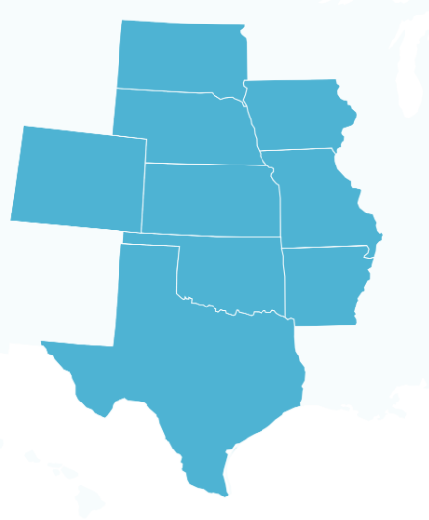

CAA MEMBER MAP
7
5
  90 Total Agencies
  9 States
  2 Members left in 2023 (Aars & Nelson / The Arrow Group)
3
18
6
4
7
37

Slide 30
KPI UPDATE

Slide 31
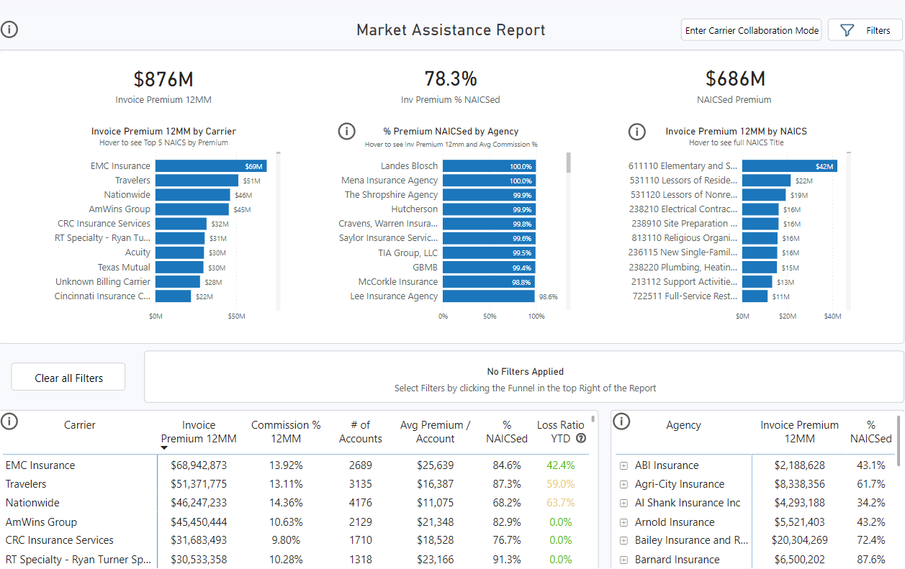

Slide 32
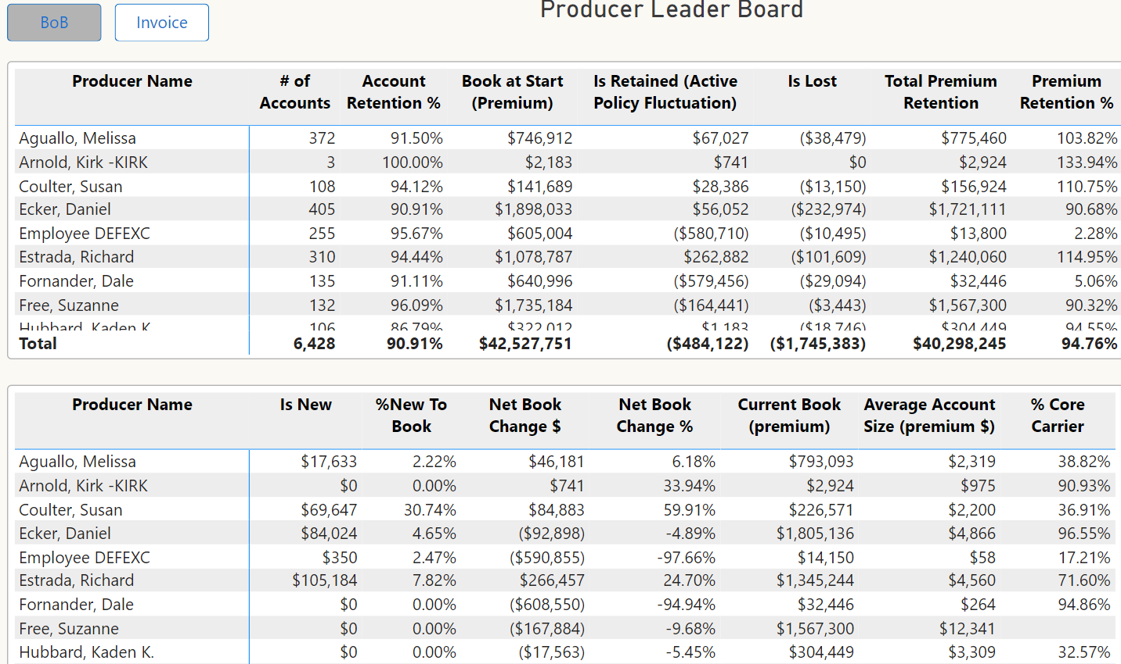

Slide 33
PREMIUM FINANCE UPDATE

Slide 34
CURRENT STATE
  CAAPFF Finances all Notes $75K and Under
  $1,930,791 in member capital
  Estimated $35 Million Financed in 2023
  2023 estimated 15% pre-tax return

Slide 35
2024 CAAPFF CHANGES
  Increase Finance Limit to $150,000
  Allow new members who are using program to invest up to $20,000
  Seven Members - $140,000
  Allow Ryder Rosacker & Patterson to Invest up to Total of $100,000
  Allow Members on pace for $1 Mil Financed to invest $20,000
  Nine Members - $180,000
  Allow all other members using program to invest up to $5,000
  36 Members - $180,000
  $700,000 Additional Capital Raised

Slide 36




FUTURE MEETINGS
Omni
Las Colinas
Dallas, TX
Feb 28ᵗʰ-Feb 29ᵗʰ
2024
Omni
Las Colinas
Dallas, TX
July 17ᵗʰ- July 18ᵗʰ
2024
JW Marriott
Nashville, TN
Nov 6ᵗʰ-Nov 7ᵗʰ
2024

Slide 37
NATIONWIDE PET VIDEO

