Slide 1




STAFF UPDATE
CAA
JULY 2024
MILEAGE
FIRST CLASS TICKET
1997 KM
BOARD NOW

Slide 2
Lost Members 2024 | Lost Members 2024 | Lost Members 2024
Agency | 2024 Dues | 2023 Premium
GBMB INSURANCE AGENCY LLC | $42,669 | $47,453,832
Weatherby-Eisenrich Insurance | $35,912 | $27,680,990
BIBBY, BRILLING & ASSOCIATES, LLP | $25,981 | $19,285,683
BENTON LUTTRELL COMPANY | $19,390 | $15,651,253
MCCORKLE COMM INS AGENCY, LLC | $6,495 | $5,128,815
Prospera Total | $130,447 | $115,200,573
Barnard | $18,615 | $14,690,972
Sinnott | $16,881 | $10,111,147
JHC | $11,262 | $7,806,402
MKO | $51,528 | $30,966,283
Total | $98,285 | $63,574,804
Grand Total | $228,733 | $178,775,377
MEMBERSHIPUPDATE
JULY 2024

Slide 3


















LOST MEMBERS SINCE 2021

Slide 4
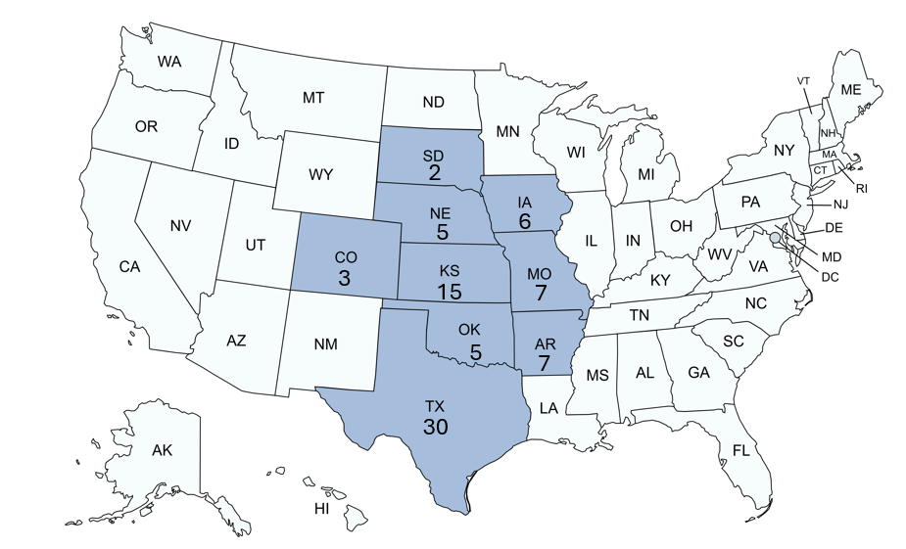
MEMBERSHIP UPDATE
80 MEMBERS

Slide 5



Slide 6










2024 GUARANTEED COMPENSATION

Slide 7
2024 GUARANTEED COMPENSATION
  0.5% GC Plus Profit Share
  3.85% GC
  1% Additional on NB and 0.5% Additional on Renewals
  1% GC; Earn up to 1.5% more based on CL Premium and Loss Ratio
  1% GC, up to 3% Total based on New Business
  2.5% GC on CL; 1.5% GC on PL and Farm with Loss Ratio Kickers
  2% GC; Earn up to 3% more based on Loss Ratio and Growth (KS, NE, IA, SD)
  1% GC plus Growth Kickers; Up to 3% GC Total
  3.5% GC; 3% on NB if $2.5 Mil NB
  3.9% GC on CL

Slide 8
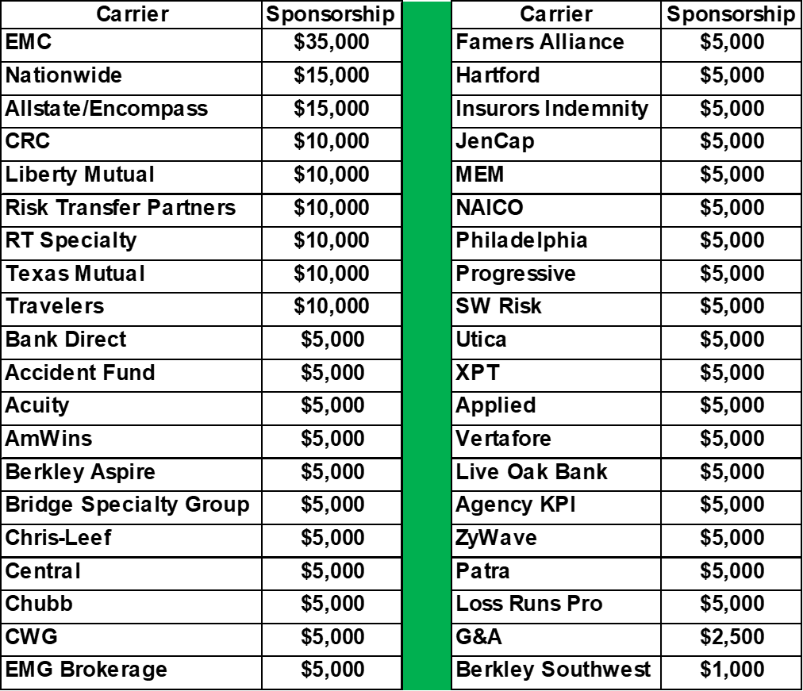
SPONSORSHIPS

Slide 9
SPONSORSHIPS
$293,500

Slide 10



TIME FOR
Q & A!

