Slide 1

BOARD MEETING
Wednesday, February 12, 2025
Dallas, TX

Slide 2
Agenda
  2026 Progression
  2024 CAA Results
  Membership Update
  2025 Carrier Compensation
  2024 Profit Share Update

Slide 3








CAA2026
Member commitment to being a good partner
Member commitment to profitable agency growth
100% Member participation in CAA Strategic Plan & Initiatives
ACCOUNTABILTY
CULTURE
$1.5 BILLION Premium Volume=$180M Revenue
$3.1 B
$3.1 BILLION Premium Volume=$240M Revenue
Break-even budget
1% COST
Documented strategy working for carrier partners.
An accountability model working regarding commitments for member agencies
80% AGGREGATED
Excellent, hired and working professional staff with strong communication model
4.5 EMPLOYEE ENGAGEMENT

Slide 4
2024 Results

Slide 5
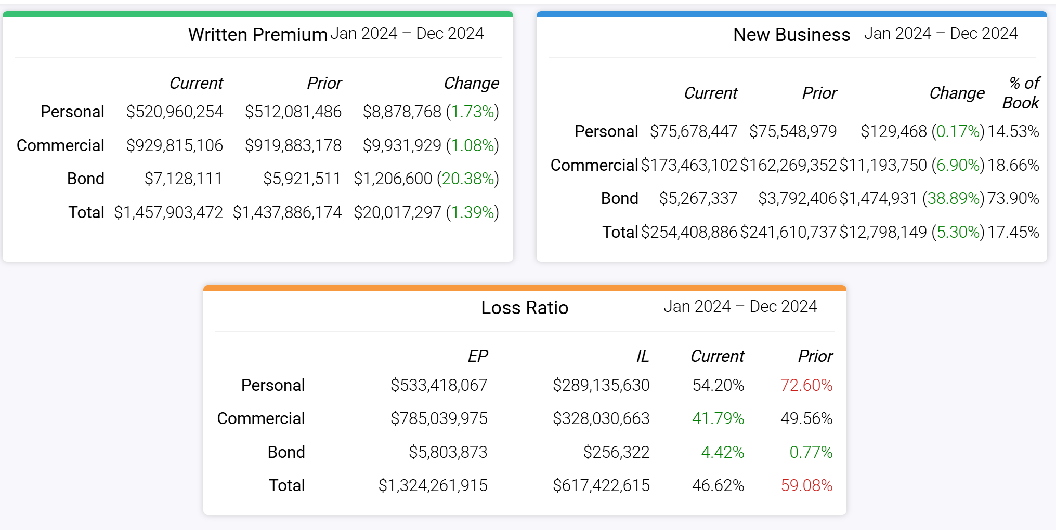
2024 CAA Core Carrier Production

Slide 6

2024 CAA YERF Information
Not Reporting: Hutcherson, SBS, T.R. Baker, Tyner, Vibrant

Slide 7
2024 CAA YERF Information
Not Reporting: Hutcherson, SBS, T.R. Baker, Tyner, Vibrant

Slide 8
Membership Update

Slide 9
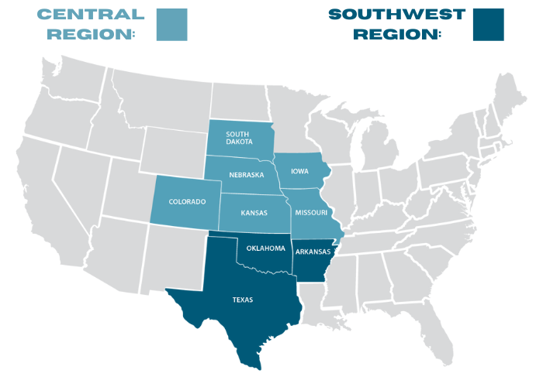
CAA Member Map
3
7
5
81 Total Agencies
9 States
3
18
6
5
7
38

Slide 10
Lost Members
Texas
Barnard JHC Bibby Benton Luttrell GBMB McCorkle
Weatherby
Central Region
MKO Sinnott Relion Insurance Loft

Slide 11
New Member
McGrath Insurance Group – Missouri
Tri County Agency – Missouri
Heritage Insurance Group – Iowa
Jensen Agency – South Dakota
Stephenson Insurance Group - Iowa
Current Prospects
Bravara – North Dakota
WalkerHughes – Indiana
Mandeville Insurance - Montana

Slide 12
2025 Carrier Compensation

Slide 13
Nationwide 2025
PL 1.5% Plus based on loss ratio below 60% up to 2% total (Same as 2024)
Farm 2% Plus based on loss ratio below 55% & growth over 3.3% up to 3% total (Increased)
CL 2% Plus; info to follow up to 2.5% total (.5% decrease from 2024)

Slide 14
EMC 2025
4.25% GSC
$8.5 Mil New Business Incentive
Percentage Over Plan | Increase
0 – 10% Over Goal | +.25 Point
10 – 25% Over Goal | + .50 Point
25% or More Over Goal | +1 Point

Slide 15
Travelers 2025
PI 1.5% GSC
CI 3.94% GSC

Slide 16
Guaranteed Comp Partners 2025
Nationwide (PL 1.5% Plus, CL 2.5% Plus, Farm 1.5% Plus)
Travelers CL (3.94)
Travelers PL (1.5%)
Acuity (.5% Plus Profit Share)
CWG (3.5%)
EMC (4.25%)
Columbia (KS, NE, IA, SD 2% Plus)
IMT (.5% Plus)
Philadelphia (1% Plus)
Union Standard (1% Plus)

Slide 17
Other Companies
Cincinnati
Auto Owners
United Fire

Slide 18
2024 Profit Share

Slide 21
2024 Profit Share
33% Increase

Slide 22
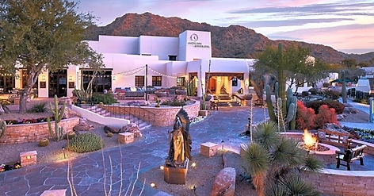
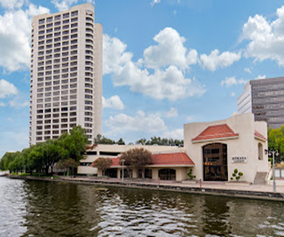
2025 Meetings
Omni Las Colinas
Dallas, TX
July 16ᵗʰ – 17ᵗʰ
2025
JW Marriott Camelback Inn
Scottsdale, AZ
Nov 12ᵗʰ – 13ᵗʰ
2025

