Slide 1

BOARD MEETING
Wednesday, February 28, 2024
Dallas, TX

Slide 2
Agenda
  CAA2023 Progression
  2023 Results
  Staff Roles & Responsibilities
  Membership Update
  Consolidation Task Force Update
  2024 Meeting Information

Slide 3
CAA 2023 Progression

Slide 4








CAA2023
“if we were sitting here 3 years from today, we would be happy…”
Member commitment to being a good partner
Member commitment to profitable agency growth
100% Member participation in CAA Strategic Plan & Initiatives
ACCOUNTABILTY
CULTURE
$1.5 BILLION Premium Volume=$180M Revenue
$1.5B
$1.5 BILLION Premium Volume=$180M Revenue
Break-even budget
1% COST
Documented strategy working for carrier partners.
An accountability model working regarding commitments for member agencies
80% AGGREGATED
Excellent, hired and working professional staff with strong communication model
4.5 EMPLOYEE ENGAGEMENT

Slide 5
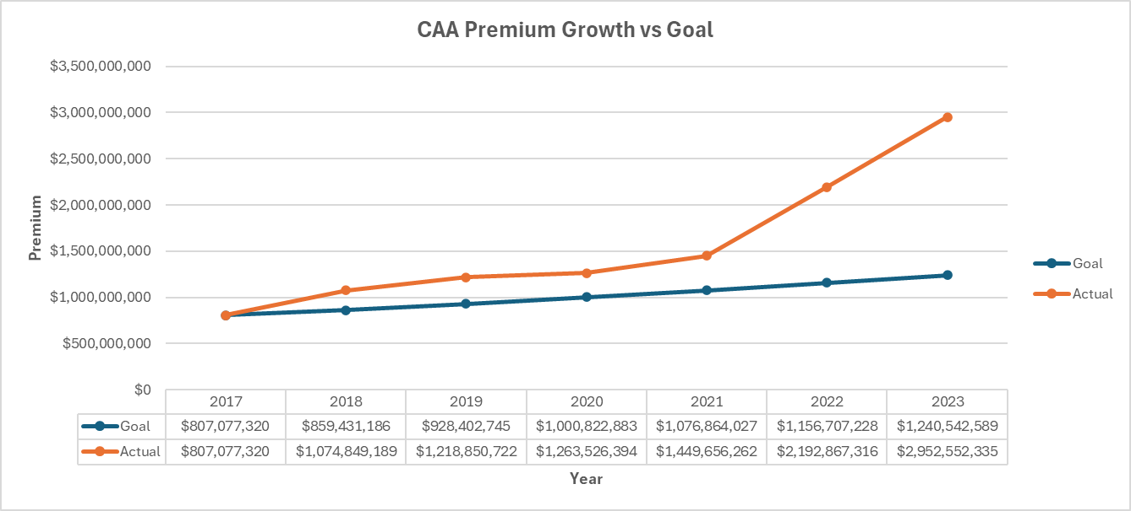

CAA Premium Projections & Performance

Slide 6
2023
Goal | Data/ Technology | Carrier Relationships | New Members | Current Member Growth | Deepen Agency Engagement | Continuous Improvement
BoM | AgencyKPI Accountability: Monthly Scorecard Upload Goal: 100% Quarterly Clarity upload Goal: 100% | Focus on Core Carrier Alignment Update Carrier Liaisons (Q1) Achieve New Business Goals with core carriers Promote CAA, the network, to your carrier relationships | Cultivate a pipeline with prospects Goal: $35 Million in premium (EOY) | 5% Organic Growth Goal Move 5% of non-core to core | Share 2023 agency business plan/goals with CAA 80% aggregation 100% agency representation at meetings Member Engagement Review Goal: 100% Q2 Deepening relationships with CAA staff, benefits | Perpetuation Plans Goal: 100% of agencies have documented plans Continue to champion internal perpetuation among members Define Mission and Vision Statement (Q1)
CAA | Implement a new CRM (Q1) Clarity: Fully implement Agency KPI (AMS 360/Epic) (Q1) Use Clarity for ’23 planning strategy Pilot Wholesale Tuner with 5 members (Q1) | Update Carrier Liaisons (Q1) Maximize carrier relationships, contracts & production strategy in all states Distribute profit share in timely-manner Strengthen relationships at the leadership level Attend impactful industry events | Expand in current states (MO, OK, CO, SD, TX) Ob-board 23 new members prior to July Meeting (Q2) Reconstruct on-boarding process After action review in Q3 (DMAIC) Update new member checklist Develop an on-board evaluation tool for continuous improvement (Q2) | State Meetings (outside of BoM meetings) (Q2) One per “region/state” Assisting in carrier alignment Help agents move 5% of non-core to core | 80% aggregation Deepening relationships with member agency/ staff CRM Roll-out (Q1) Assist with “OCT” established from Feb BOM Meeting (Q1) Benefits survey completed (Q1) Producer development task force (Q1) Implement | 2024 Strategic Plan (Q4) Quarterly Staff Reviews & Workshops 2/year community service activities (annual) Utilize CRM system to communicate with members(Q2) Evaluate & develop core carrier relationships CAA marketing/branding guidelines (Q1) Evaluate vendor relationships (Q1) Aligned benefits with state associations (Q2)
CAAIS | Implement Tarmika in Processes and Procedures (Q1) Utilize Patra to its fullest capacity | Collaborate with CAA on relationship management: Production goals by carrier/by region Track & report progress on goals/production | Incorporate IS in onboard process Goal: new members using IS New members using new submission checklist MGA analysis – rolling books quicker | Strong adoption of IS with a solid % of members Increase volume by agency MGA analysis – rolling books quicker Graduate members to direct appointment | Member knowledge of IS - who, what, why, how, when? | Increase Bind Ratio IS Team development Designations: TIIA, ACSR/CISR Continue building new staff structure with regional teams CIS guide- brochure
Notes:
6

Slide 7
2023 YTD Results

Slide 8
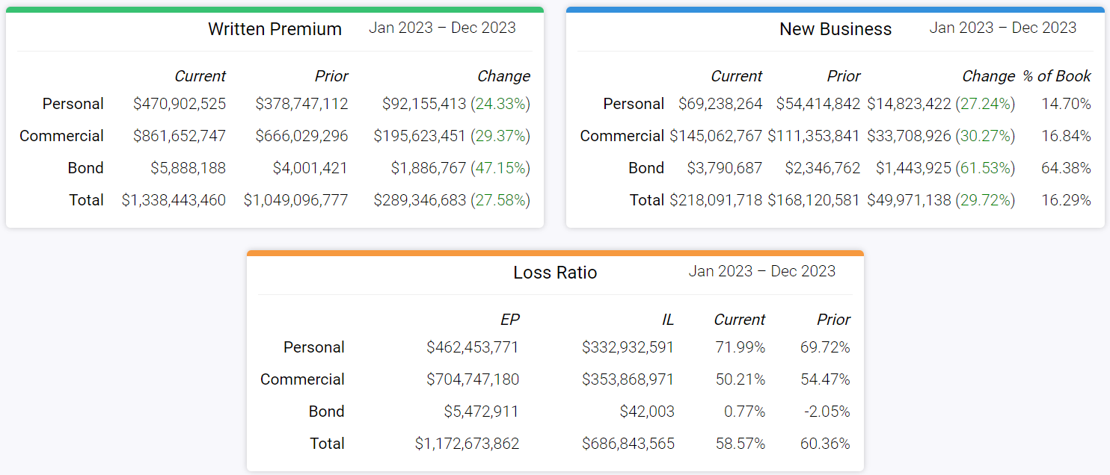
2023 CAA Core Carrier Production

Slide 9
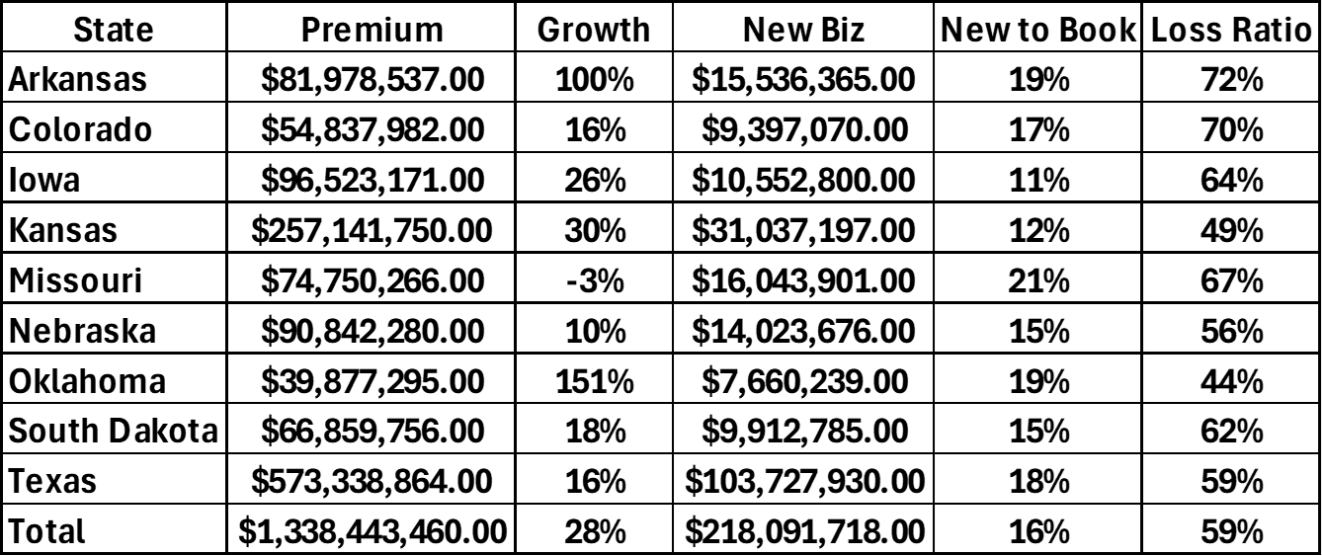
2023 CAA Core Carrier Performance by State
Does NOT Include the Following Carriers:
Cincinnati: $58 Mil Auto Owners: $70 Mil UFG: $29 Mil

Slide 10
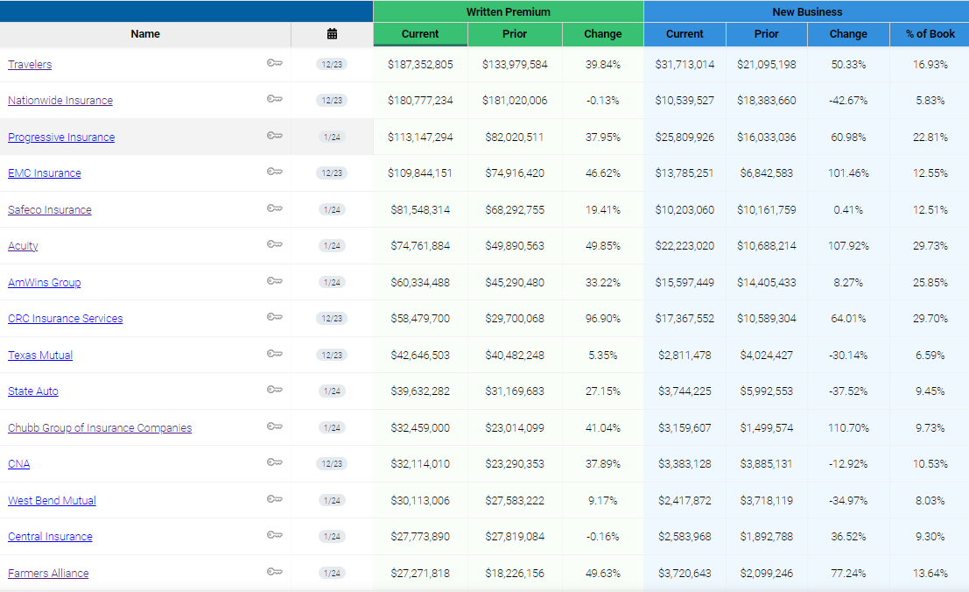
Top Carriers

Slide 11
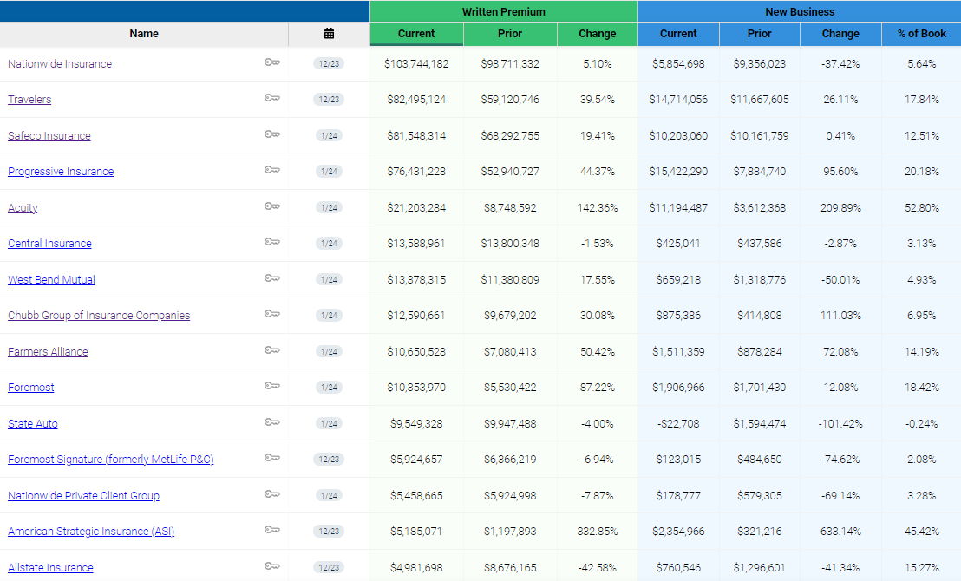
Top Personal Carriers

Slide 12
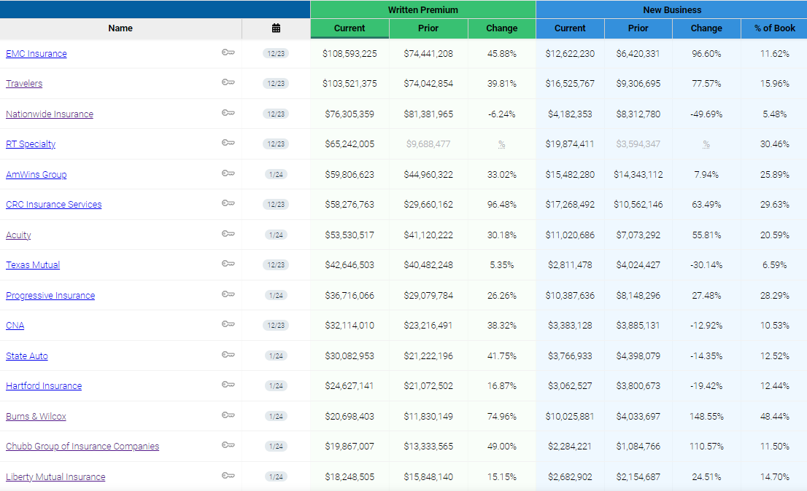
Top Commercial Carriers

Slide 13
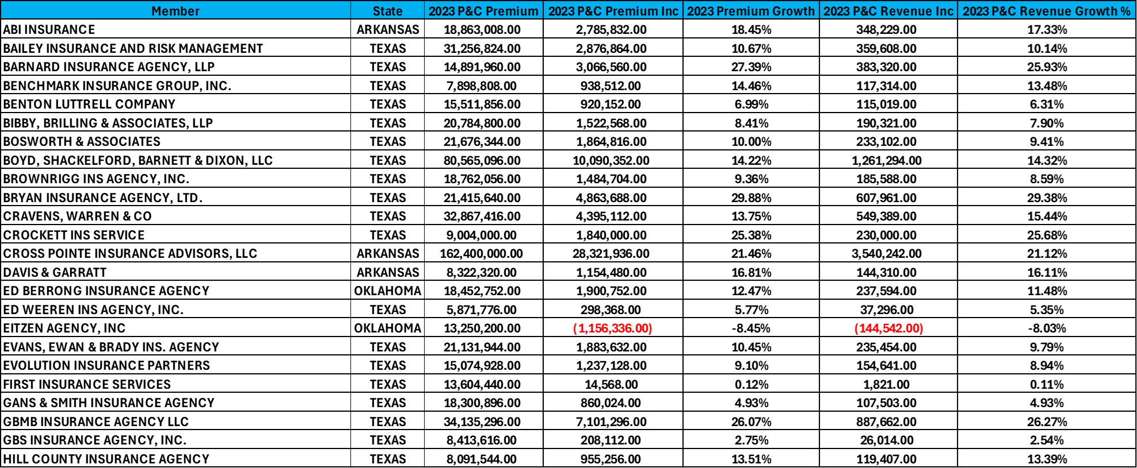
2023 Southwest Member Performance

Slide 14
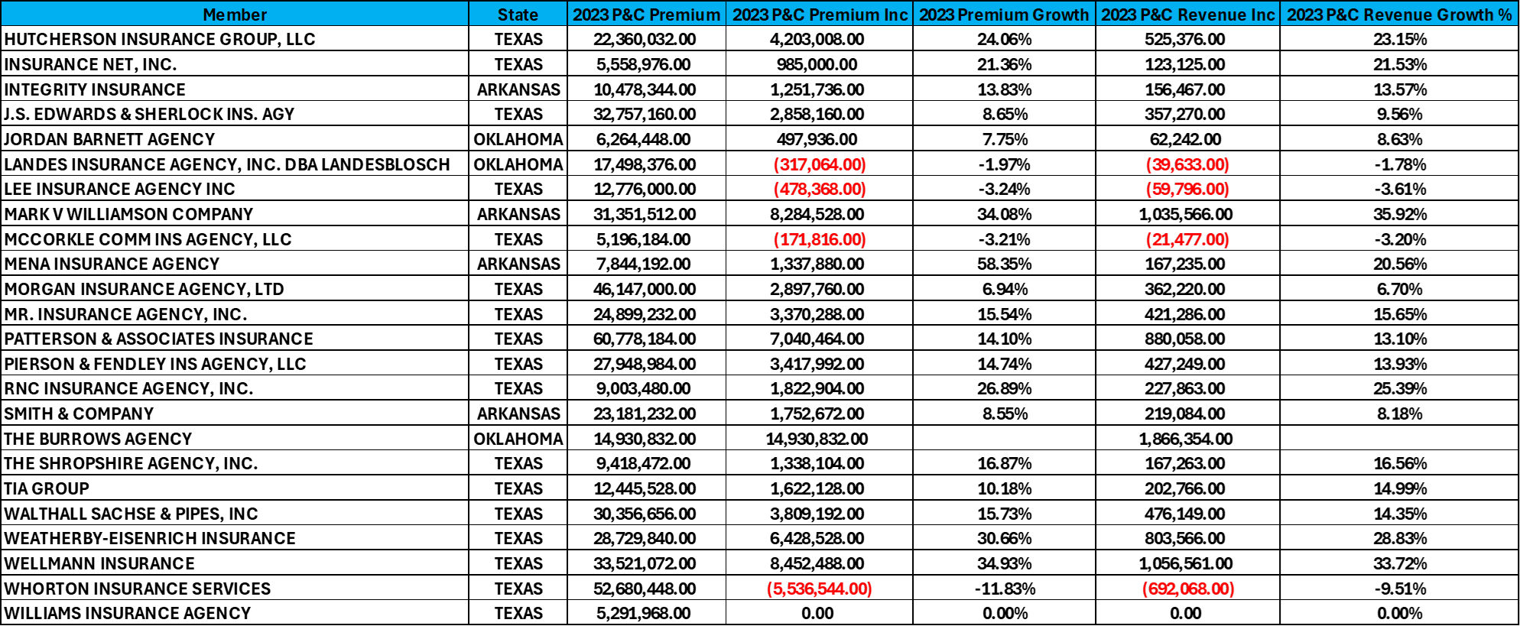
2023 Southwest Member Performance

Slide 15
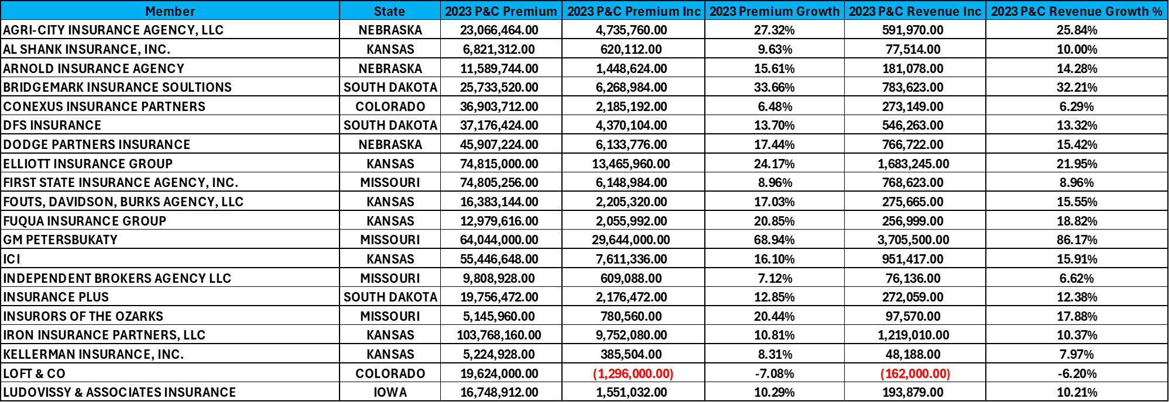
2023 Central Member Performance

Slide 16
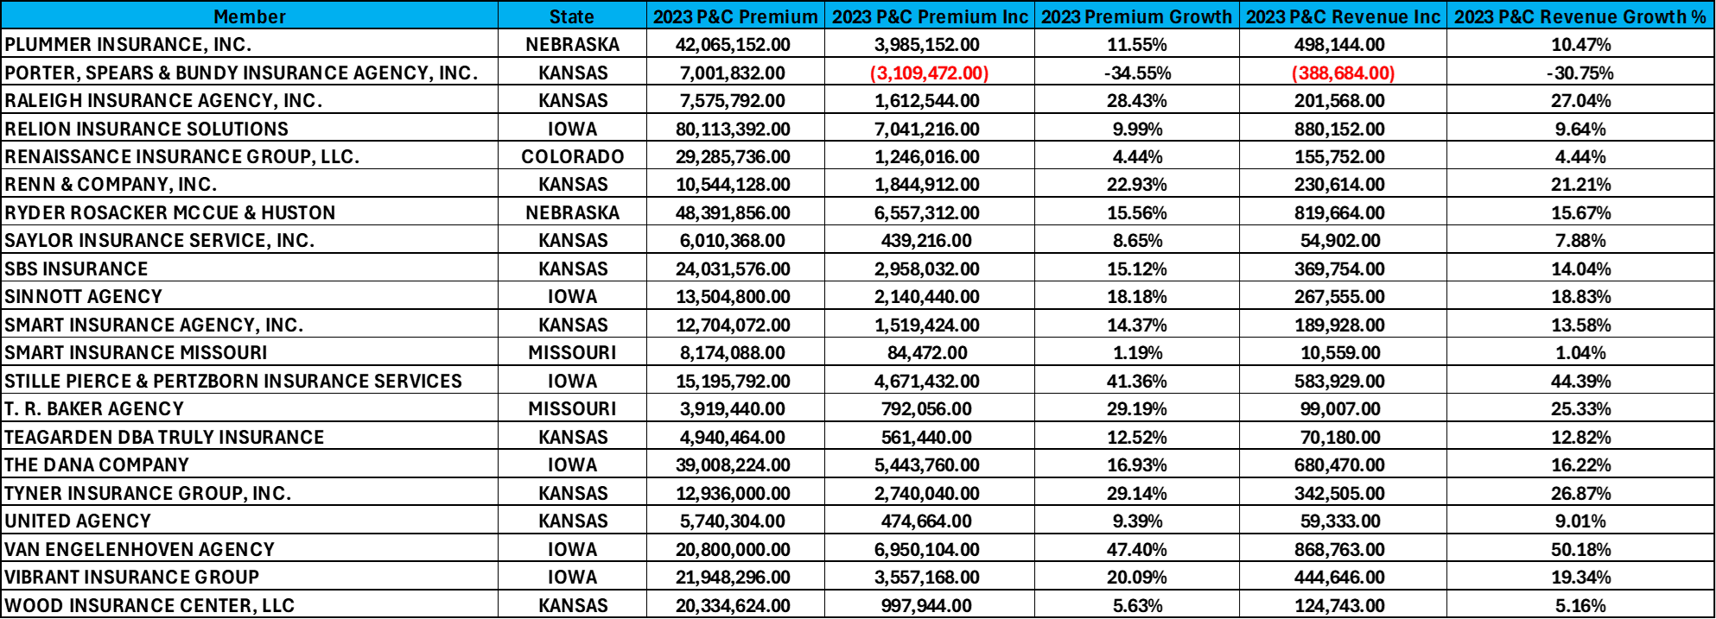
2023 Central Member Performance

Slide 17
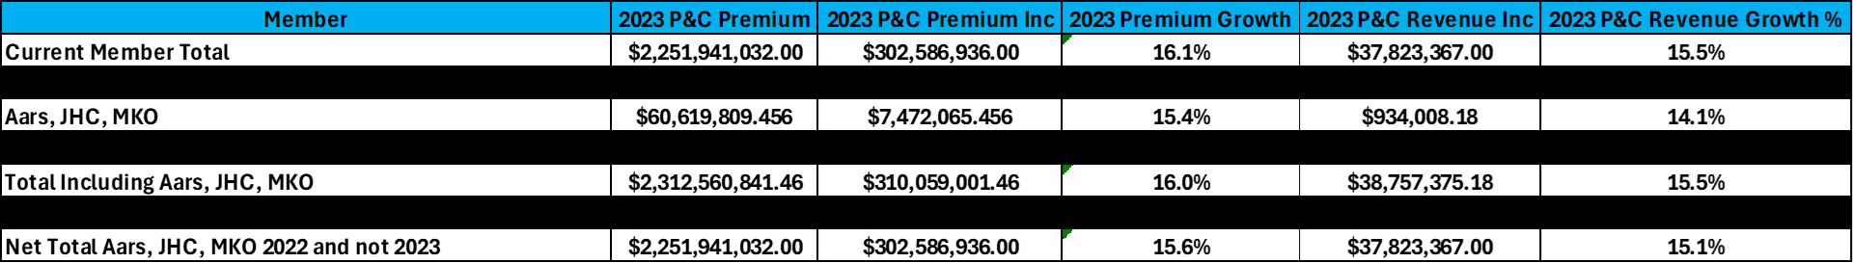
2023 P&C Premium and Revenue

Slide 18
Staff Roles & Responsibilities

Slide 19
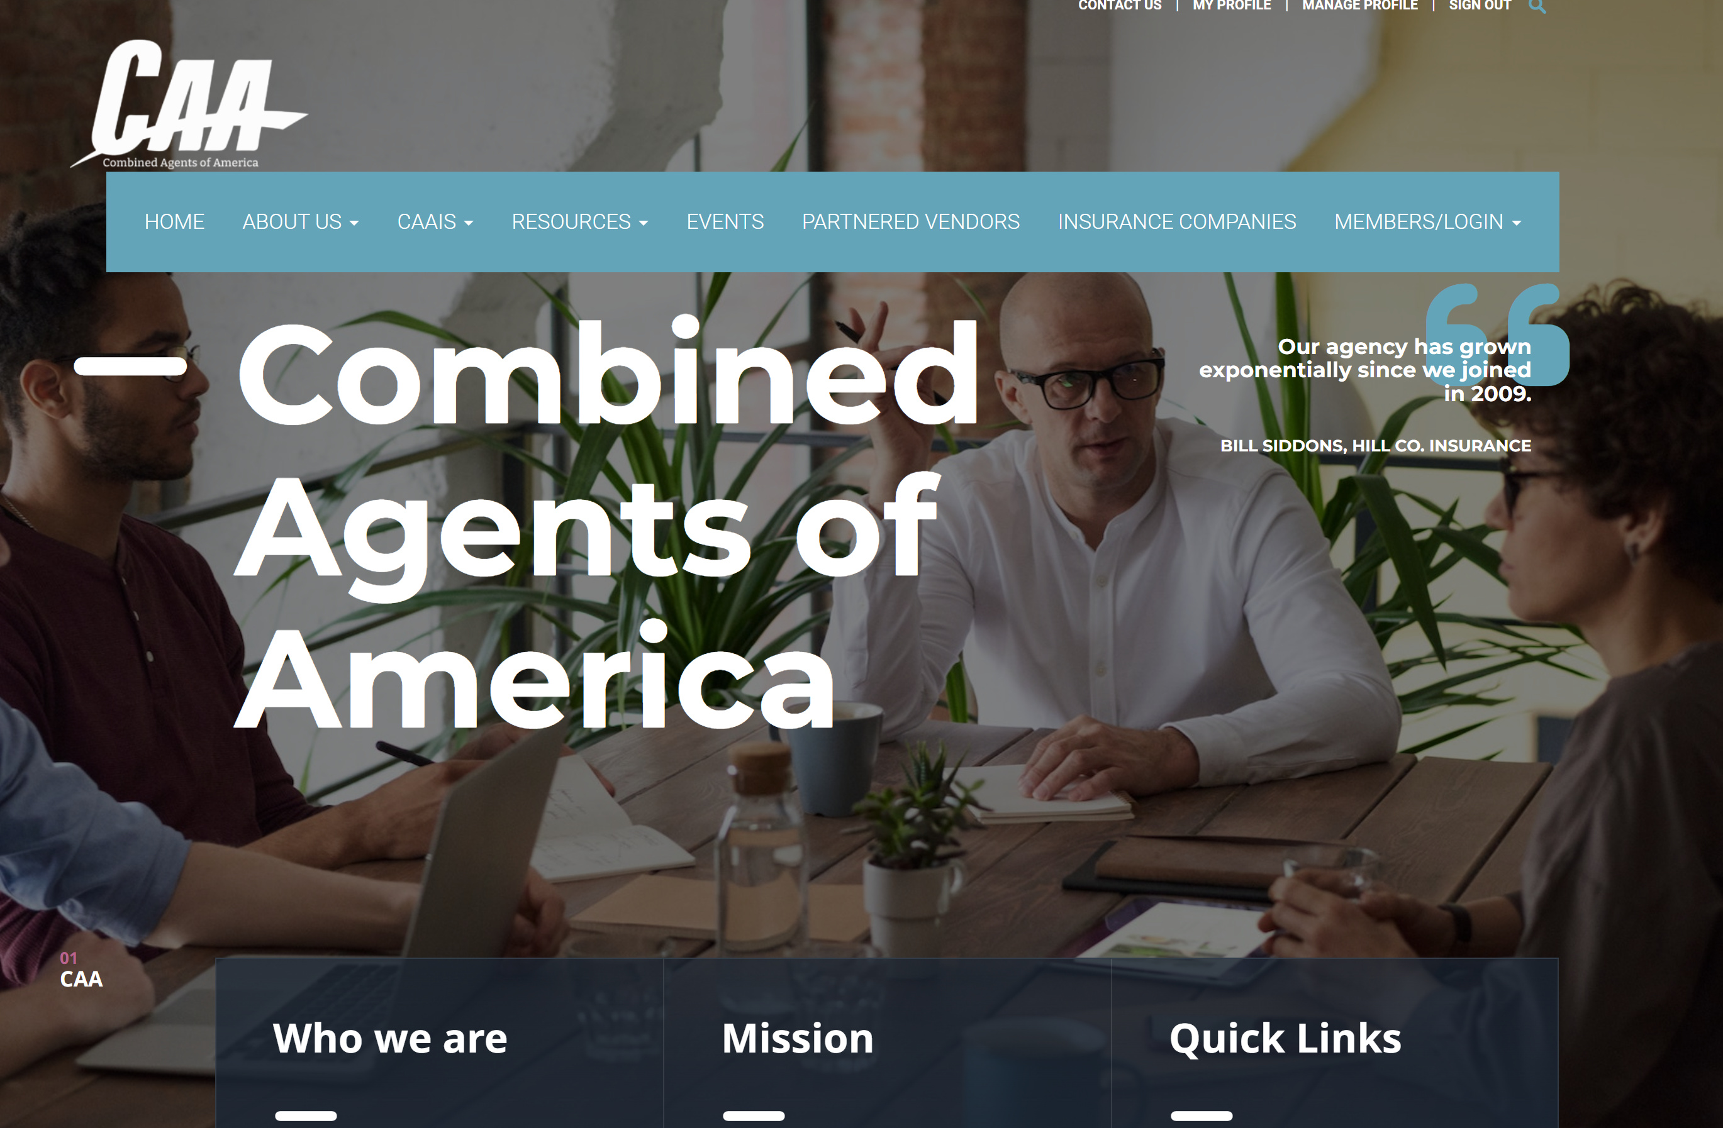
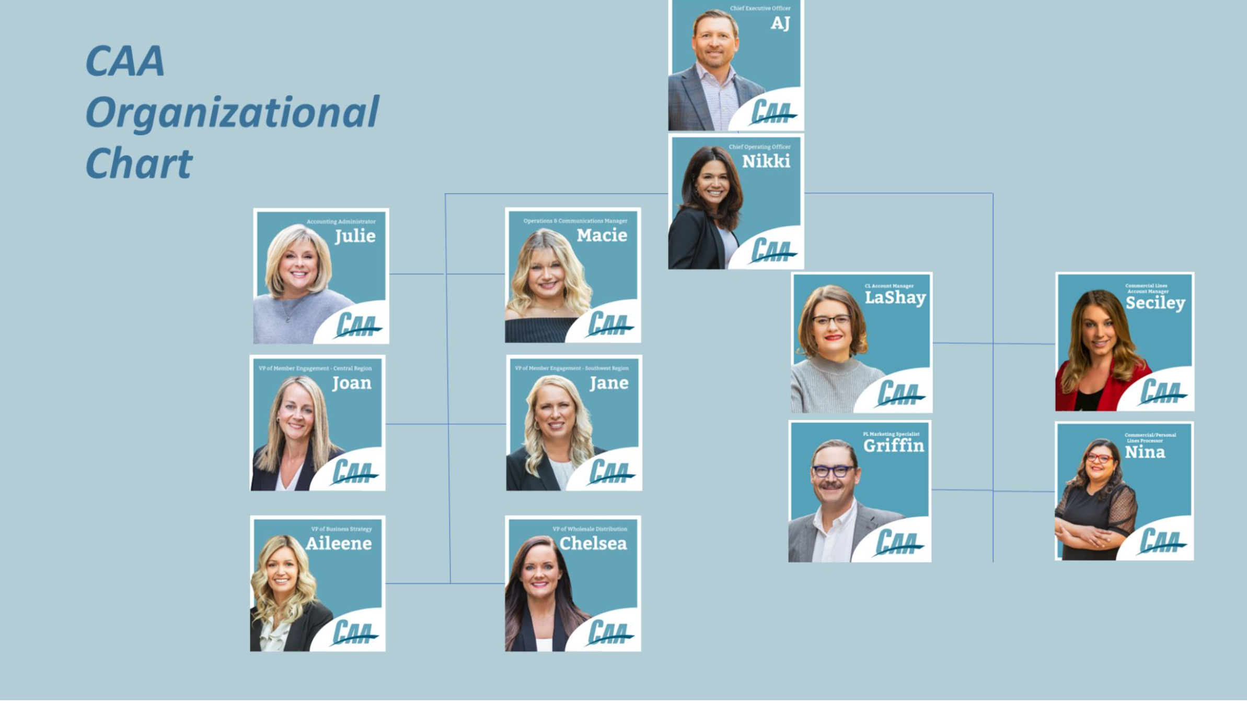
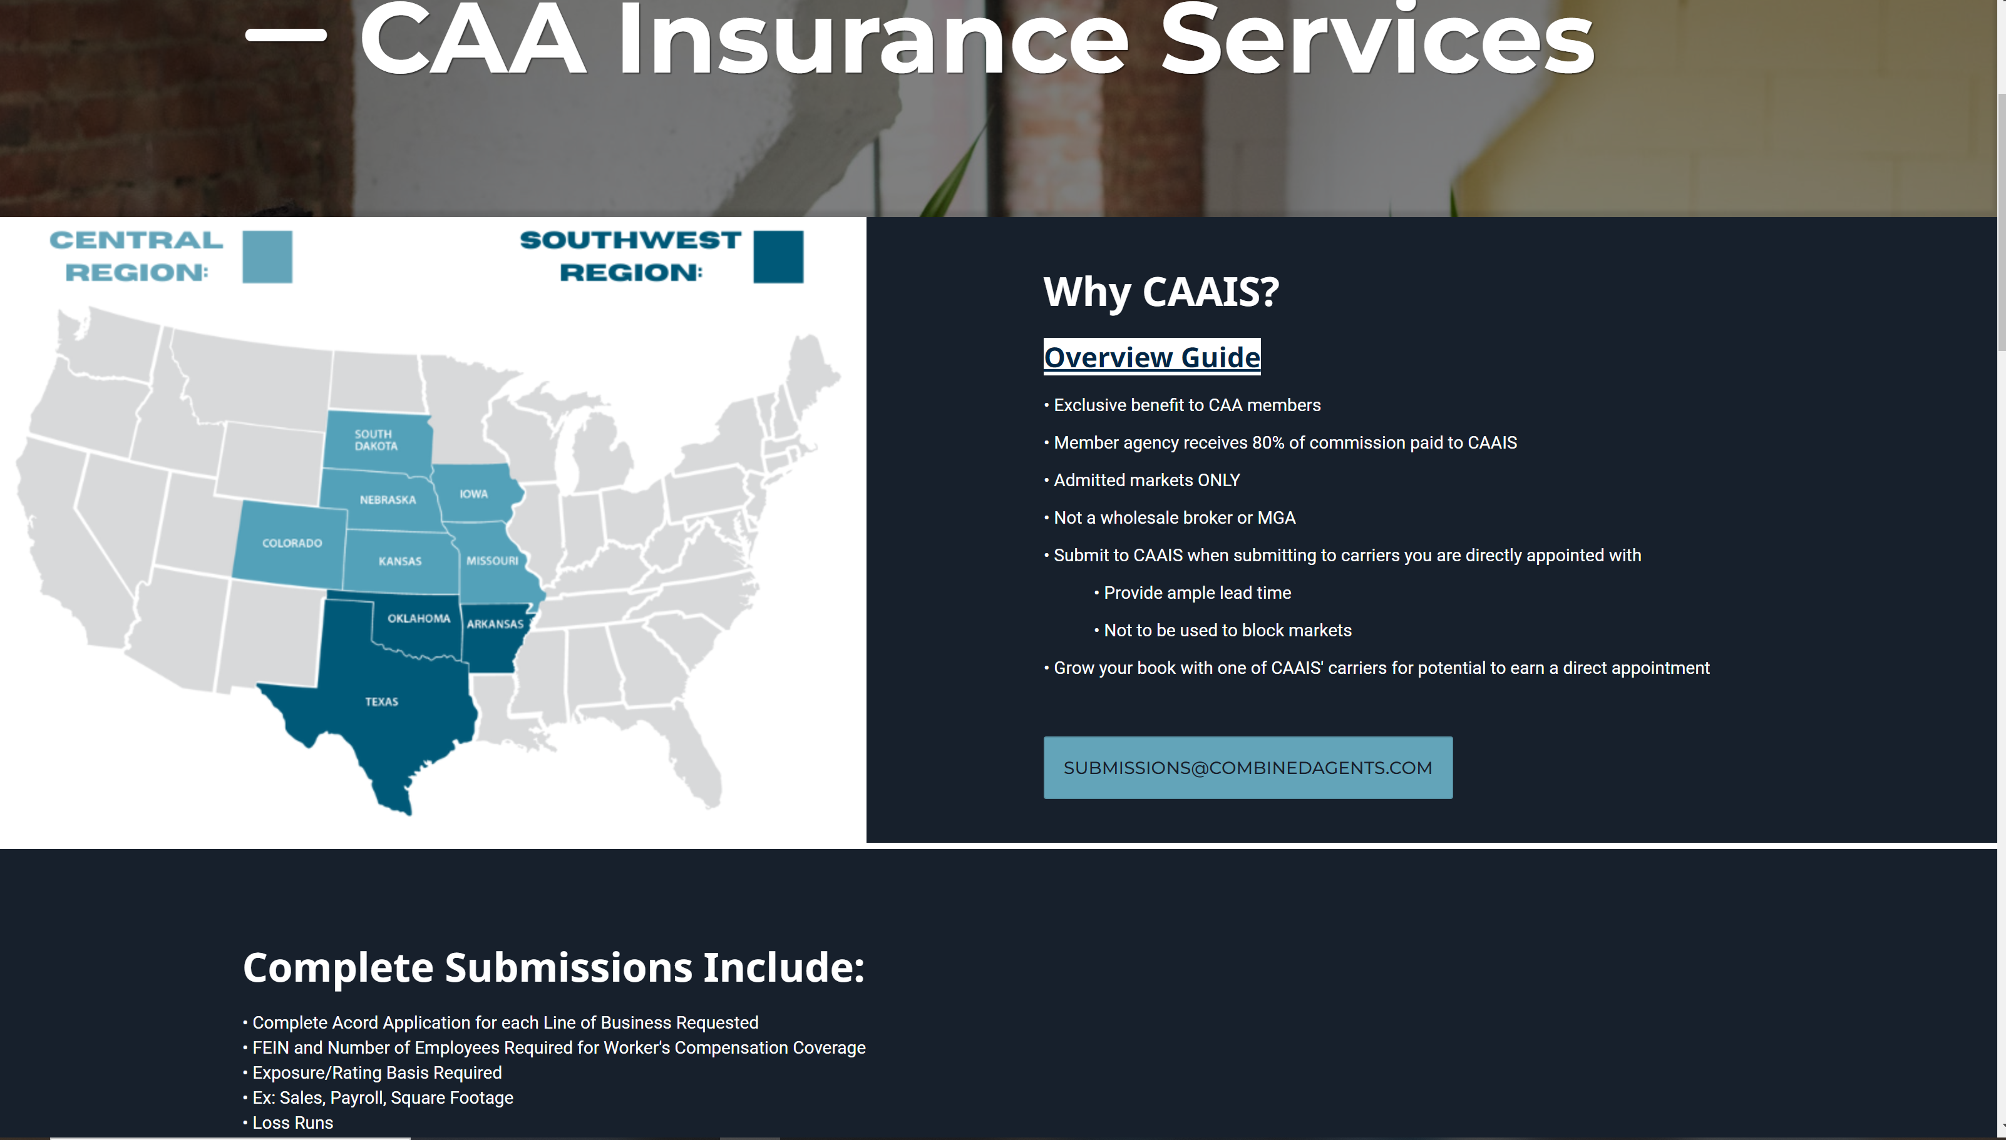
https://combinedagents.com/

Slide 20

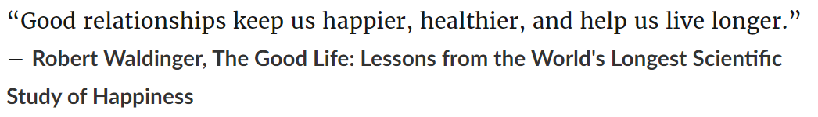

Slide 21
Membership Update

Slide 22
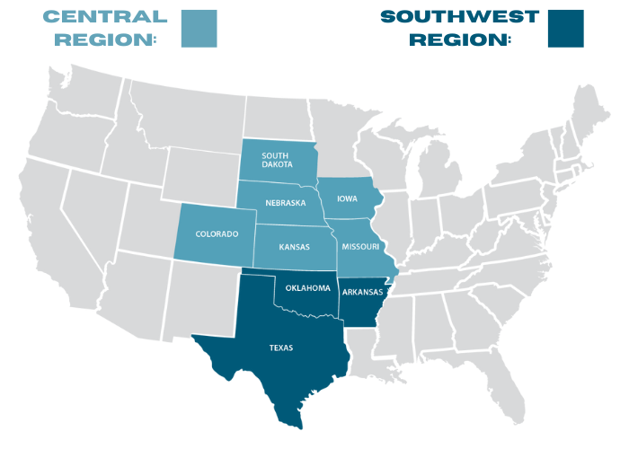
CAA Member Map
3
7
5
87 Total Agencies
9 States
1 New Member 2023
3
18
6
5
7
38

Slide 23
New Member
The Burrows Agency – Oklahoma
Current Prospects
McGrath Insurance Group – Missouri
Hutchinson & Co – Missouri

Slide 24
Lost Members
Aars & Nelson – Asked to Exit
McKinneyOlson – Sold Outside CAA
JHC – Sold Outside CAA
The Arrow Group – Sold Outside of CAA

Slide 25
Consolidation Task Force

Slide 26
Consolidation Task Force
  Focused on E&S
  CAA $520 Mil E&S
  Over 600 Wholesalers
  $250 Mil E&S with Non-Core
Bosworth Moved/Committed to move $450K

Slide 27
Consolidation Task Force
  Wholesalers Owned by Other Agencies

Slide 28


2024 Meetings
Omni Las Colinas
Dallas, TX
July 17ᵗʰ – July 18ᵗʰ
2024
Nashville Marriott
Nashville, TN
Nov 6ᵗʰ - Nov 7ᵗʰ
2024

